Slide 1




FACE MASK DETECTION
CSP 571
GROUP 26
BY: SAKSHI DIXIT (A20547504)
Aakansha Bora (A20539671)
Rhea Philip (A20536406)

Slide 2


INTRODUCTION
FACE DETECTION:
Face detection is an AI based computer technology used to find and identify human faces in digital images.
This system is able to identify that there is a human face present in an image or video.
FACE MASK DETECTION:
In these COVID-19, times wearing of mask is most essential for our safety.
Face mask detection is a system to recognize, if a user is wearing or not wearing a mask.
It detects the people with orwithout a mask.

Slide 3


PROBLEM STATEMENT
This project focuses on developing a Face Mask Detection System to ensure compliance with mask-wearing guidelines, which is critical for public health post-COVID-19. By automating the detection and classification of individuals as masked or unmasked in real-time, the system reduces manual effort and errors in crowded spaces. Scalable and efficient, it is designed for deployment in diverse environments such as schools, workplaces, malls, and healthcare facilities, enhancing public safety and preventing the spread of infectious diseases.

Slide 4

OBJECTIVE
To detect whether a certain person on camera is wearing a mask or not.
Providing data sets to an learned model which can identify a person's face in a given image.
Dataset Types: People without masks & People with masks
By passing any image dynamically, it can detect if a person is wearing a mask or not.

Slide 5
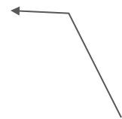
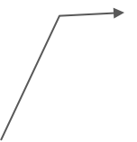
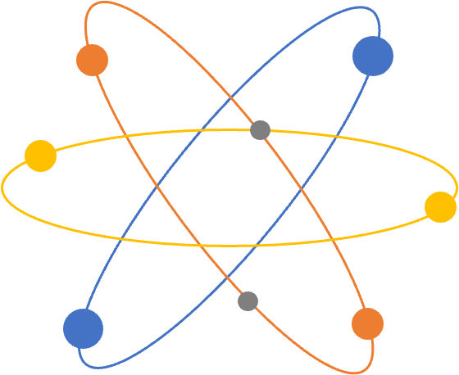
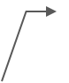
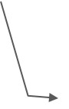
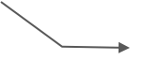

APPLICATIONS
5. Common Places
Schools & Colleges
2. Office
6. Train
7. Road
3.Airport
8. Canteen
4. Hospital

Slide 6
DATASET
Dataset Overview
Total Images: Approximately 2,500
Categories:
Masked: Individuals wearing masks.
Unmasked: Individuals not wearing masks.
Key Features:
Diverse demographics and environments.
Various angles and lighting conditions.
Purpose: Designed for training a face mask detection system.
Distribution:
Balanced/Imbalanced distribution (50% masked, 50% unmasked).

Slide 7
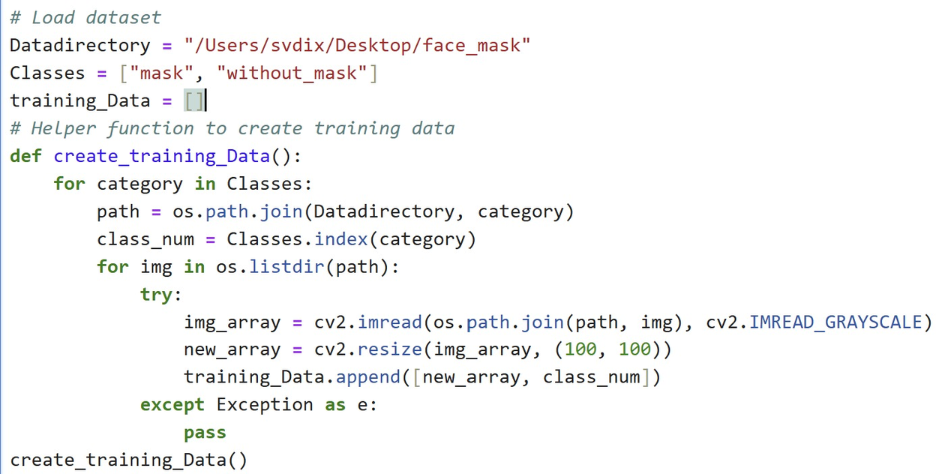
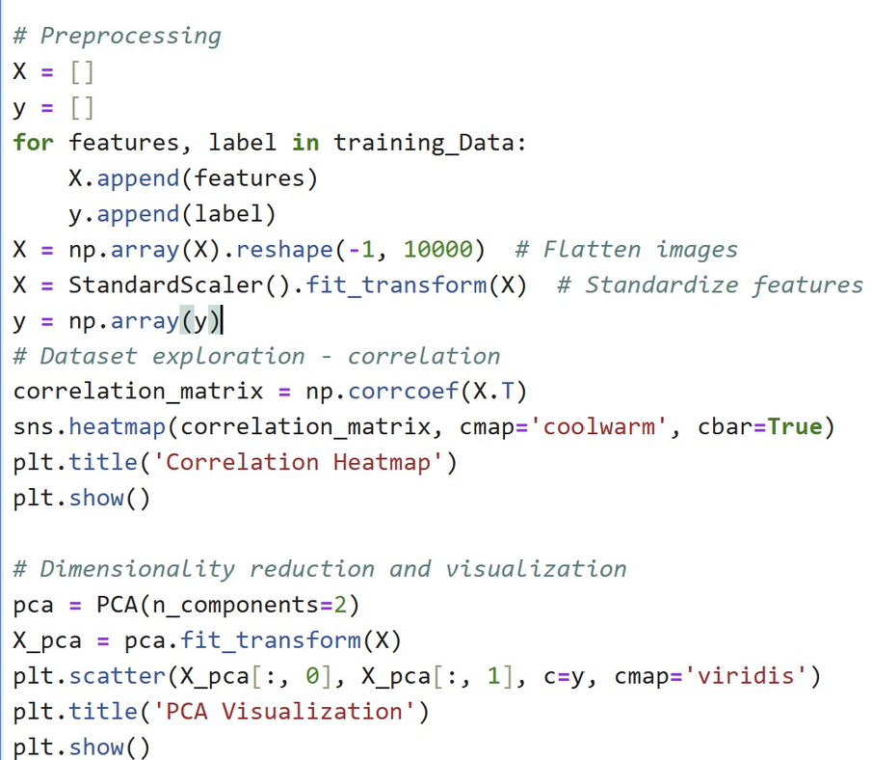
DATA COLLECTION AND PREPARATION

Slide 8



FLOW OF THE PROJECT
Image Pre-processing
Deep Learning Architecture
Identifying people with or without masks
Informing Authorities

Slide 9

PROPOSED SYSTEM
1.Train CNN(convolutional neural network) and Keras only with N-95 masks.
2.Install IRIS scan in collaboration with Mask scan to recognize the person.(Nithya, Alice & Lakshmi, C.. (2015). Iris recognition techniques: A Literature Survey. International Journal of Applied Engineering Research. 10. 32525-32546. )

Slide 10
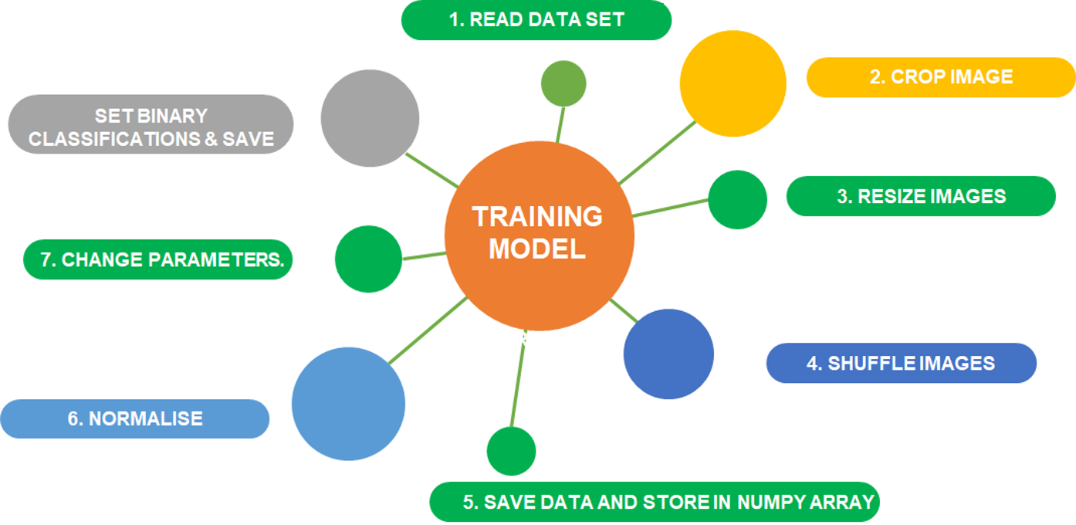
METHODOLOGY

Slide 11
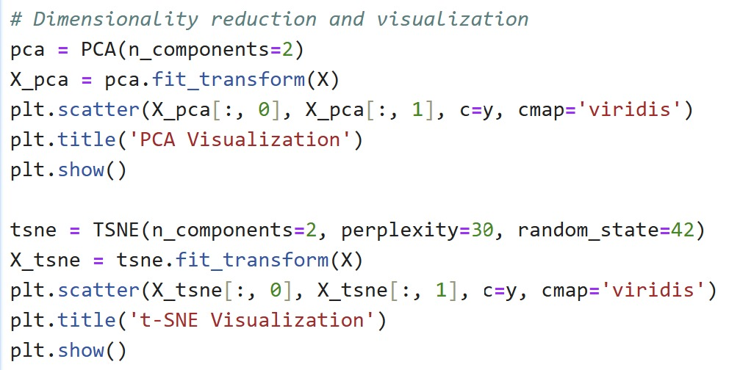
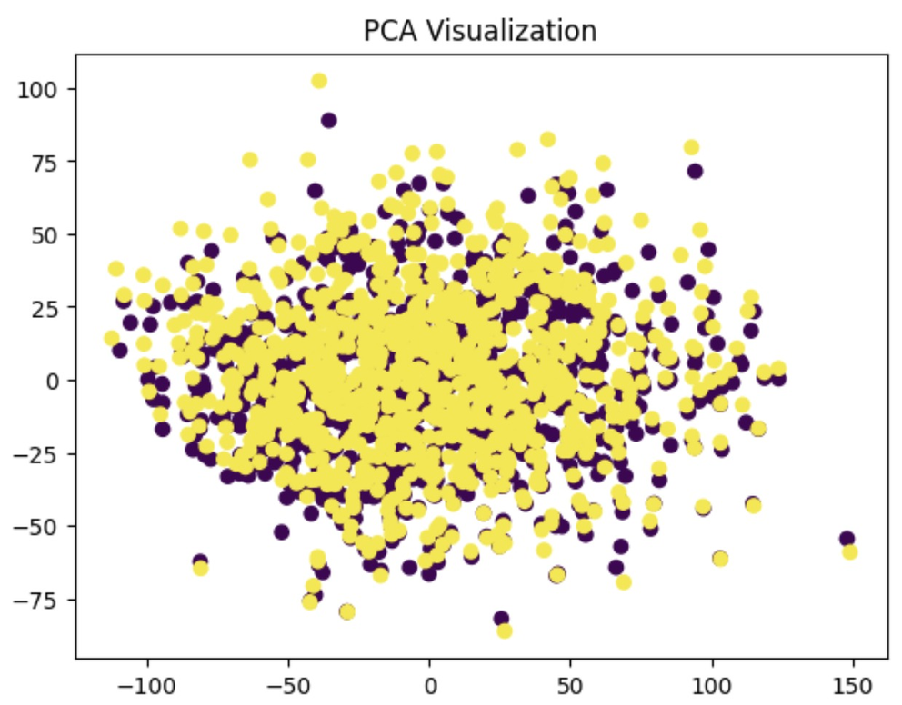
DATA VISUALIZATION STRATEGIES
TECHNIQUES USED:
PCA

Slide 12
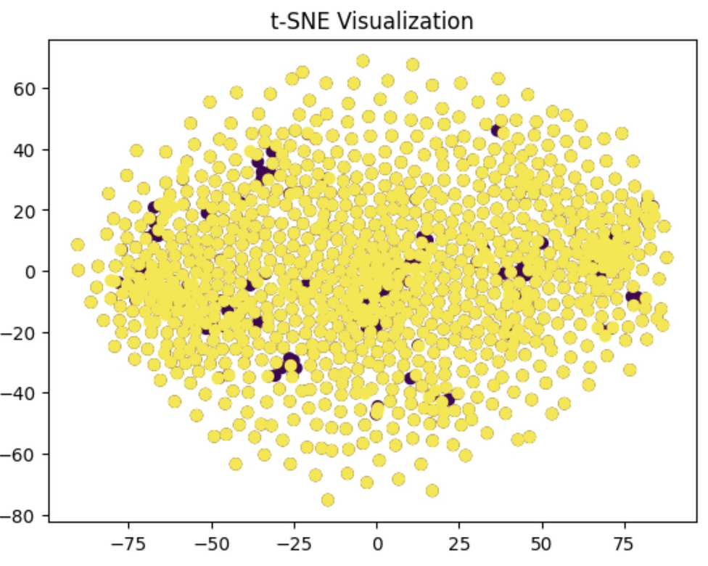
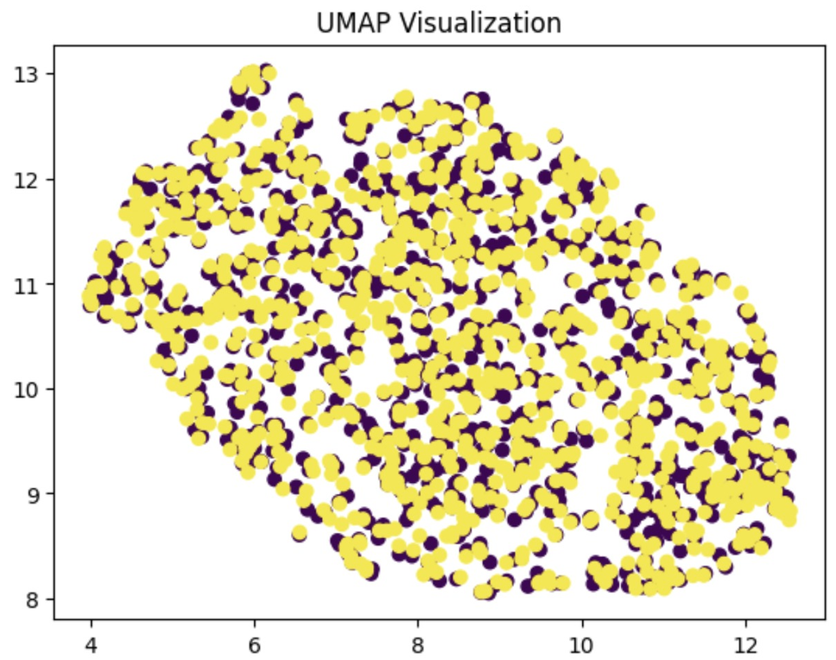
DATA VISUALIZATION STRATEGIES
T-SNE
UMAP

Slide 13
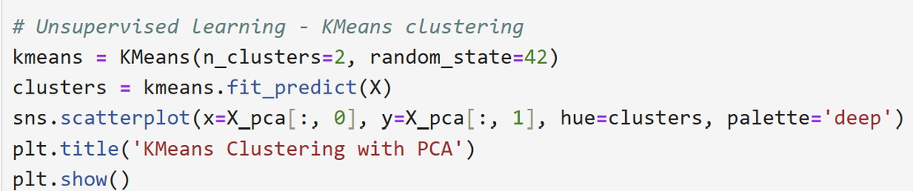
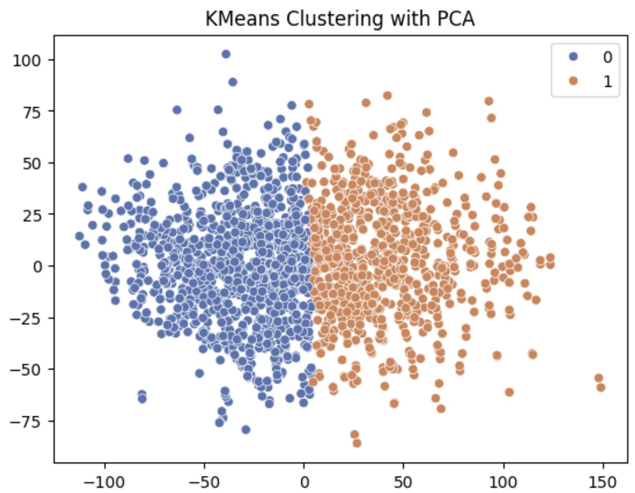
DATA EXPLORATION USING UNSUPERVISED LEARNING TECHNIQUES
The graph illustrates KMeans clustering applied to classify individuals as wearing a face mask (blue) or not wearing a face mask (orange) after dimensionality reduction using PCA.
The distinct clusters represent the algorithm's ability to separate the two categories based on features extracted from the data.

Slide 14
CROSS VALIDATION STRATEGY
The line defines a Stratified K-Fold Cross-Validation strategy, which splits the dataset into 5 folds while ensuring that the class proportions in each fold match the overall dataset. The shuffle=True parameter randomizes the data before splitting, and random_state=42 ensures reproducibility of the splits.

Slide 15
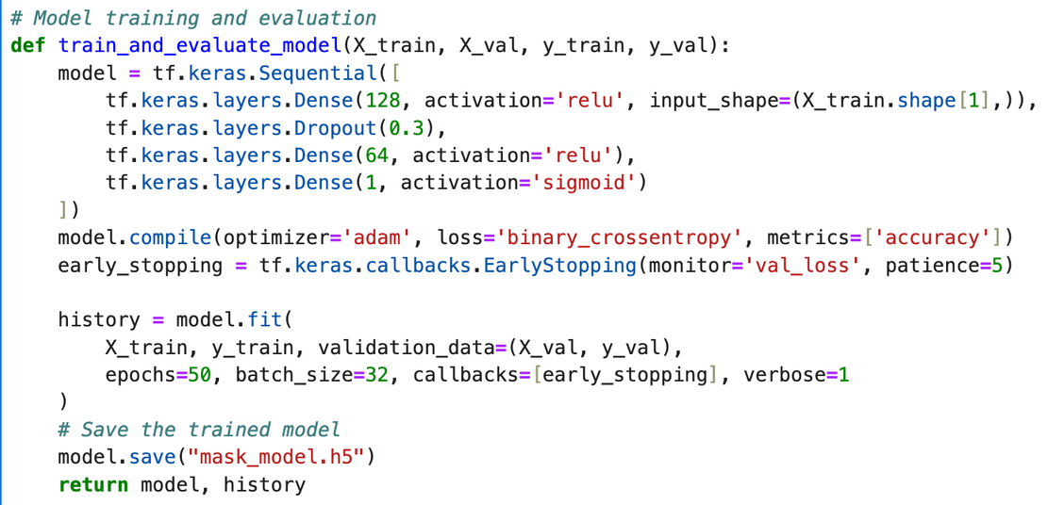
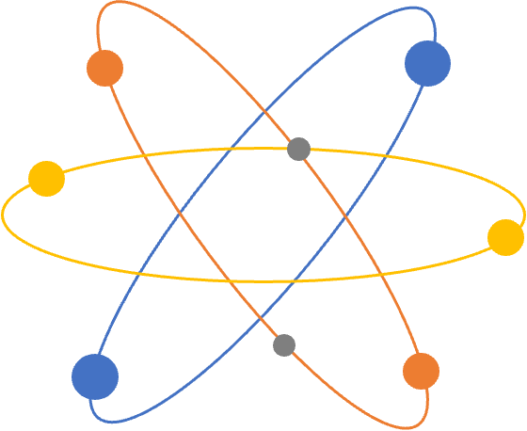
MODEL TRAINING
This code defines a function to train and evaluate a neural network model for binary classification. It uses a feedforward architecture with dropout for regularization and early stopping to prevent overfitting.
Through Stratified K-Fold Cross-Validation, the dataset is split into training and validation sets, the model is trained on each fold, and predictions are evaluated using metrics like classification report and confusion matrix.

Slide 16
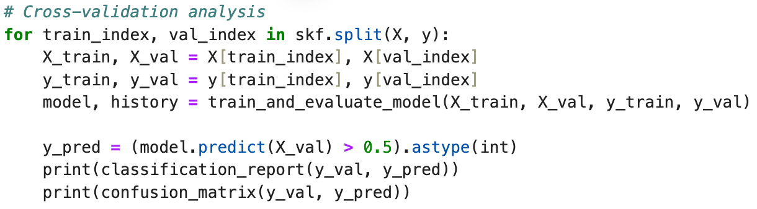
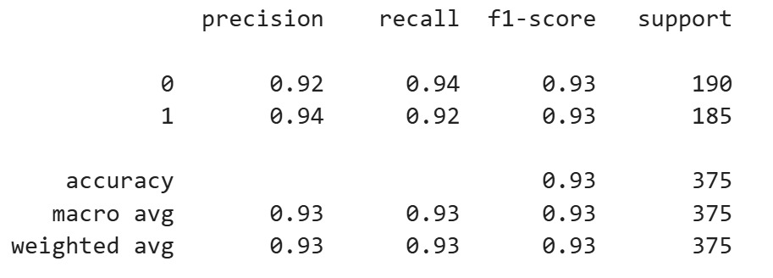
CROSS VALIDATION ANALYSIS
The classification report shows the model achieves 93% accuracy, with strong precision (92-94%) and recall (92-94%) for both classes (mask and no mask).
The classification report shows the model achieves 93% accuracy, with strong precision (92-94%) and recall (92-94%) for both classes (mask and no mask). The balanced F1-score of 0.93 for both classes indicates the model performs well across all metrics.

Slide 17
PITFALLS
The code may face issues with imbalanced datasets, leading to biased predictions and misleading accuracy metrics.
Overfitting is a potential risk, even with dropout and early stopping, especially if the dataset is small or the model is too complex.
Additionally, the fixed classification threshold and lack of hyperparameter tuning or data augmentation may limit the model's generalization and overall performance.

Slide 18
PROPOSALS FOR IMPROVEMENT
Perform feature selection using techniques like recursive feature elimination.
Apply regularization techniques such as L1 or L2 penalties.
Experiment with deeper or more complex architectures.
Augment the dataset for better generalization.

Slide 19

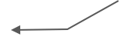
METHOD 1: FACECAM
Turn on the Facecam
Normalizing
Cropping Image Dynamically
Loading trained model on cropped image
Resizing
Result

Slide 20
METHOD 2 :
IMAGE UPLOAD
Upload an image
Prediction
Preprocessing
Result
Model Loading
Display Result

Slide 21

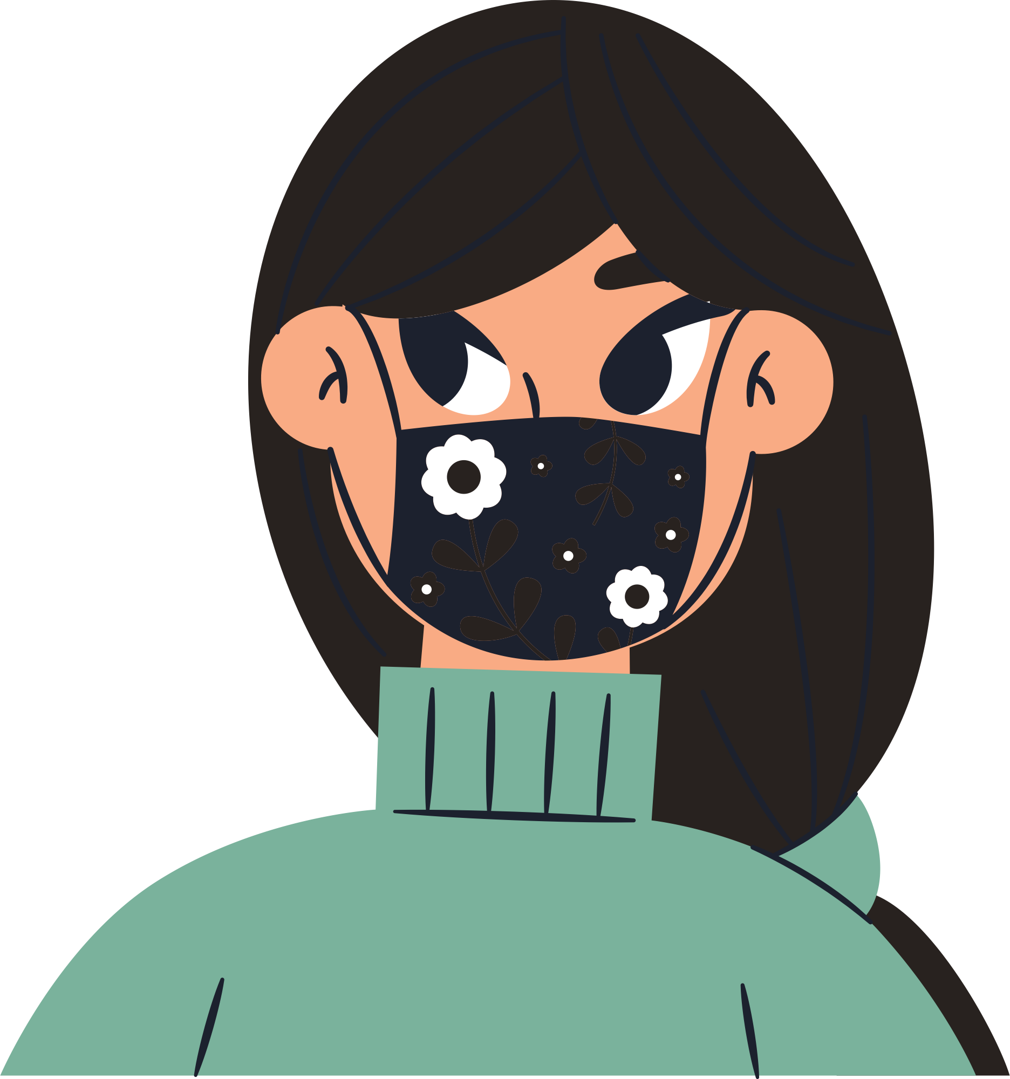
CONCLUSION
In conclusion, the combination of dimensionality reduction techniques like PCA, t-SNE, and UMAP effectively visualized the data and helped uncover the structure within the classes. Cross-validation with StratifiedKFold and a well-defined neural network model trained on the dataset resulted in strong performance, achieving 93% accuracy and a balanced F1-score of 0.93, demonstrating the model’s ability to accurately classify "mask" and "without_mask" samples.

Slide 22
THANKYOU!!

